Slide 1
Agglomerative Hierarchical Clustering

Slide 2
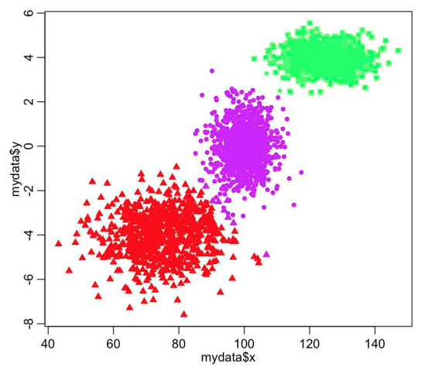
CLUSTERING
- Unsupervised Algorithm
- Grouping related data together.

Slide 3
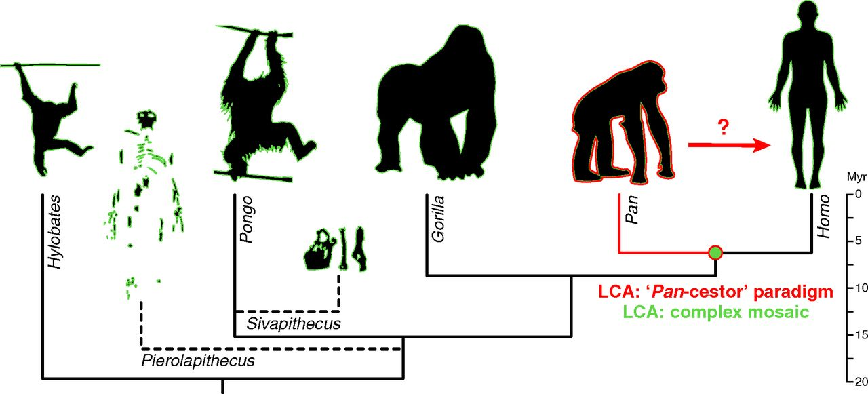
AGGLORMERATIVE HIERARCHICAL CLUSTERING
Build hierarchy of clusters
Initially, each point is a separate cluster
Bottom-up approach; keep merging clusters until you have a single cluster
Example: Phylogenetic Tree

Slide 4
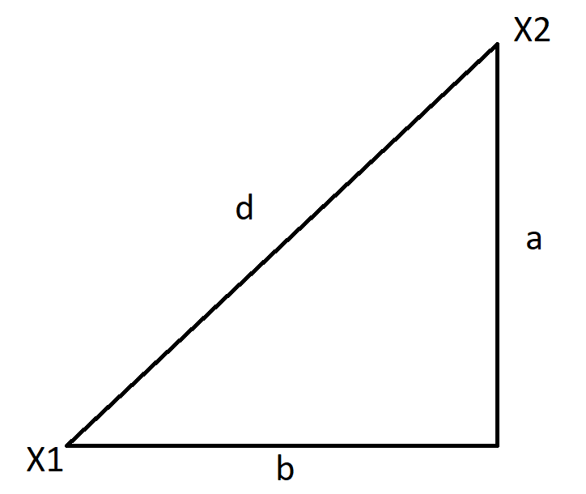
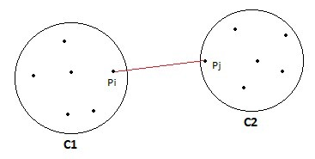
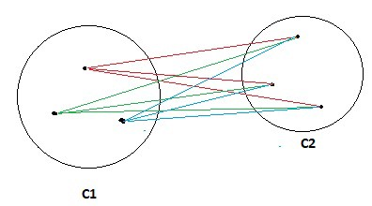

MATHS
Distance between two points:
Euclidean Distance : $d=$ $\sqrt{a^{2}+b^{2}}$
Manhattan Distance : a + b
Distance between two clusters:
Minimum Average

Slide 5
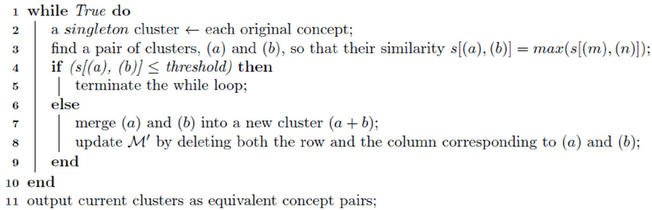
PSEUDOCODE
M’ is the distance matrix which stores the distances between clusters

Slide 6
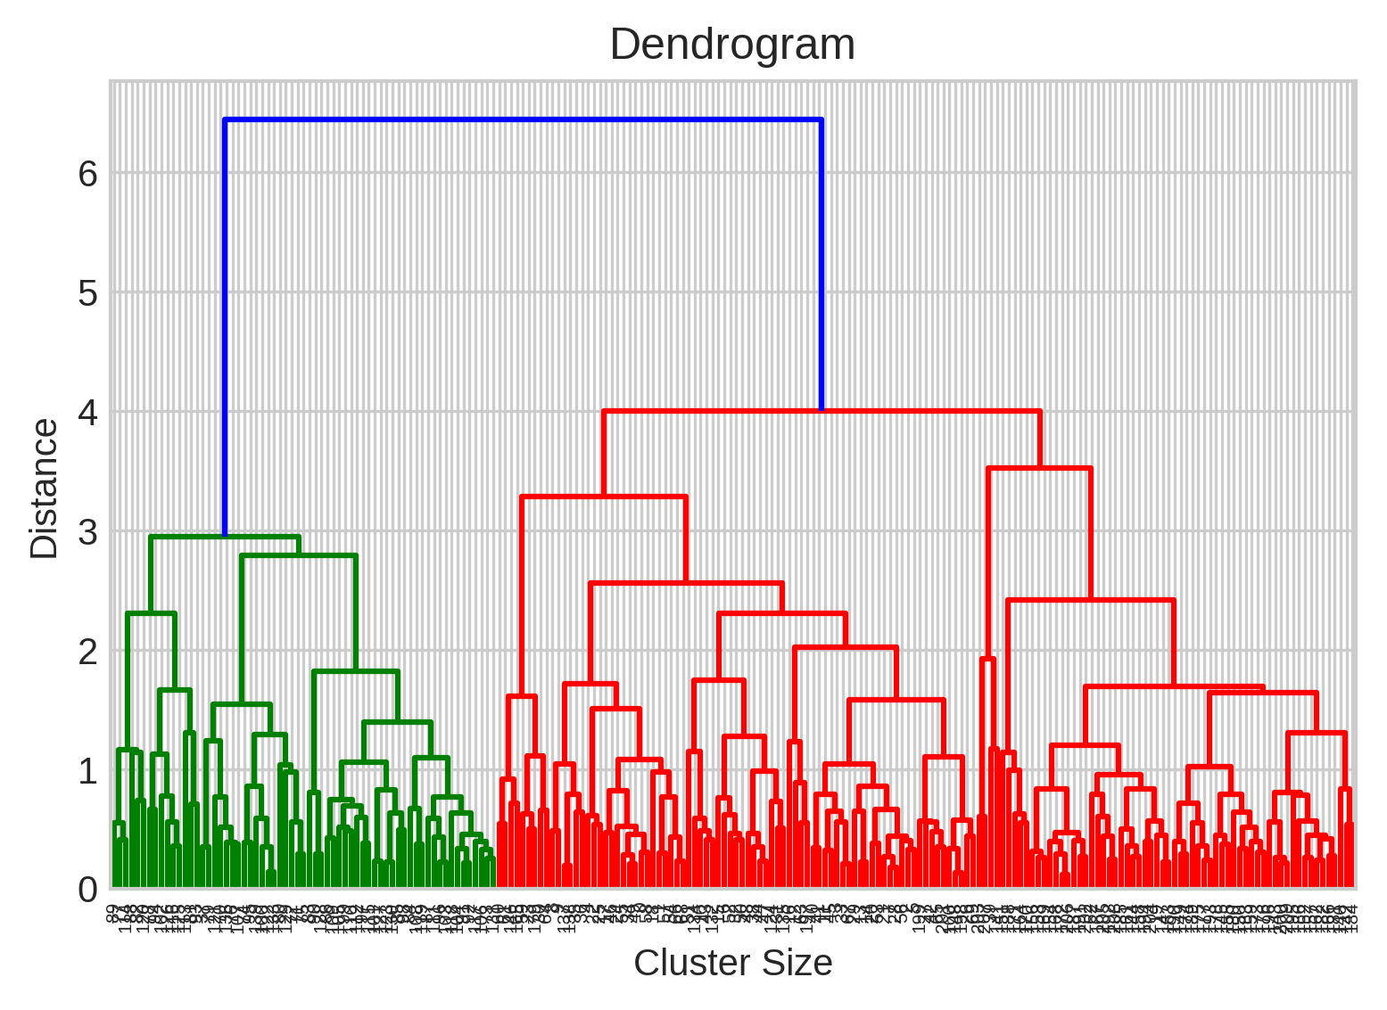
DATASET
Seeds Dataset ( https://archive.ics.uci.edu/ml/datasets/seeds )
7 attributes, 3 classes and 210 data points.

Slide 7
RESULTS
Model Accuracy
\ Points Clusters \ \ | Euclidean | Manhattan
Minimum | 30.95 % | 35.23 %
Average | 36.19 % | 81.43 %
Best Obtained Accuracy : 81.43 %

Slide 8
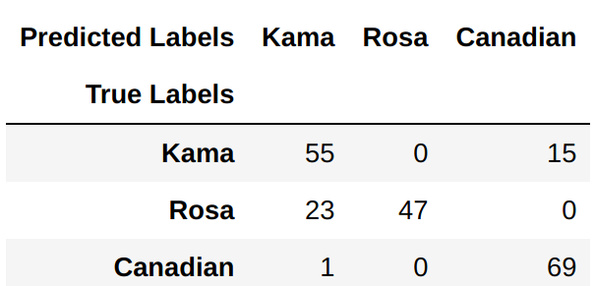
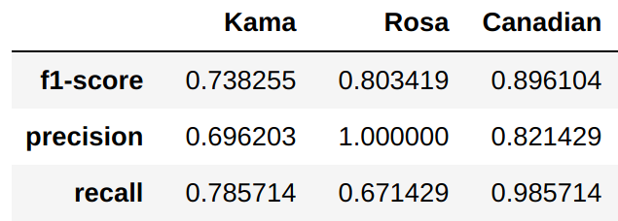
CONFUSION MATRIX
CLASSIFICATION REPORT

